Slide 1



BICING · PREDICTIVE ANALYTICS · UB / UPC NORD
Predicting
E-Bike Depletion
at UB/UPC Nord
813K+
hourly Bicing records
6
stations analysed (UB/UPC Nord)
2021–24
A spatiotemporal analysis of Bicing station behaviour
around Barcelona's major university campuses (2021–2024)
4 years of data
€0.10
fee per e-bike ride
Notes:
I analysed four years of Bicing data for Barcelona's UB/UPC Nord university campuses to build a system that predicts e-bike depletion 24 hours in advance.

Slide 2
Students arrive at empty stations and Bicing loses revenue
THE PROBLEM
🎓 The Student Problem
💶 The Revenue Problem
Class ends between 13:00-20:00
Students head to the nearest Bicing station
E-bikes are gone — wait or walk or take bus
Repeated frustration erodes trust in the service
E-bikes: €0.10 fee on every single ride
Mechanical bikes: €0.10 only if ride > 30 min
(Most student commutes are shorter)
Zero e-bikes = zero revenue from that demand
Goal: Predict e-bike depletion 24 hours ahead — enabling proactive restocking before students are stranded
Notes:
The problem: Students finish class between 1-8pm, head to the nearest station, and the e-bikes are gone.
That's a service failure. But it's also a revenue failure — every e-bike ride generates €0.10.
Mechanical bikes only trigger that fee for rides over 30 minutes, which most student commutes don't reach.
So zero e-bikes while there’s demand means zero revenue from that demand.

Slide 3
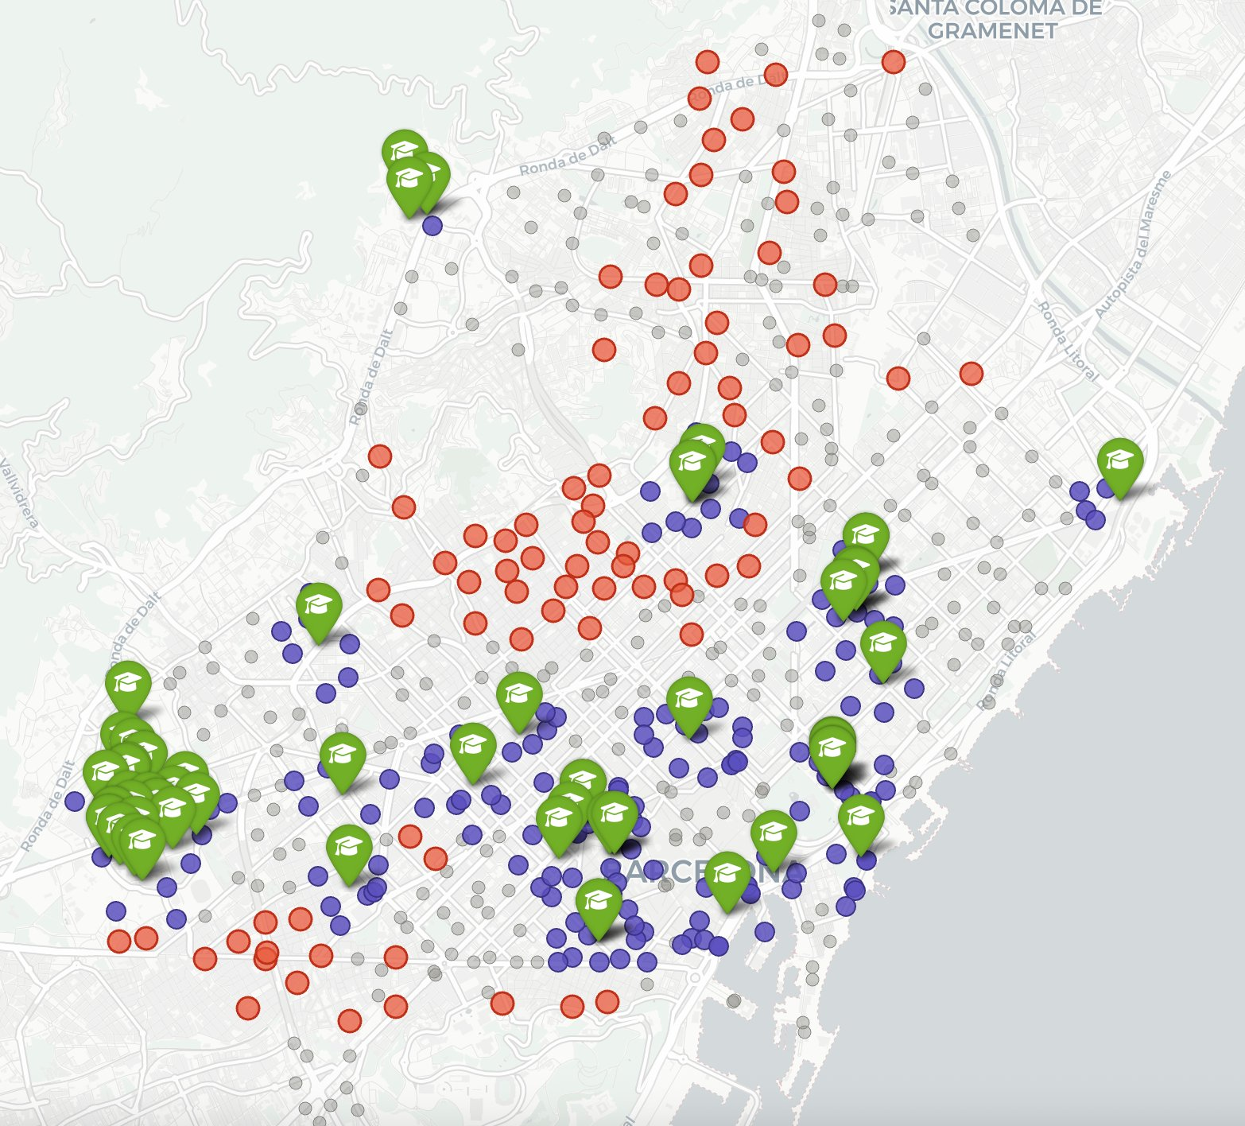
From 1,650 Educational Institutions to 3 university clusters
METHODOLOGY
University campus (A few major campuses shown)
Cluster station (≤500m from major campuses)
Potential donor stations (identified using temporal data)
Rest of Bicing network
3 University Clusters identified
UB/UPC NORD
UPF Ciutadella
UB/UPC Nord · UB/UPC Sud · UPF Ciutadella
30 stations total within 500m of campus centroids
Why 3 clusters, not all 127 stations?
UB/UPC SUD
A global model across all nearby stations would mix student commuters with tourists, locals, and general commuters — reducing signal quality.
Notes:
Barcelona has 1,650 educational institutions and over 500 Bicing stations.
Rather than building a global model that mixes students with tourists, residents and commuters,
I identified 3 university clusters of bike stations within 500 metres of major university campuses in the city — 30 stations total, and tried to isolate the student demand signal.
Of the three clusters, UB/UPC Nord stands out immediately.
It’s almost an isolated student zone away from touristic and more commercial areas.

Slide 4
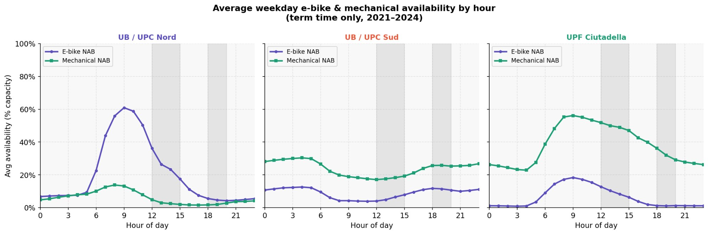
UB/UPC Nord behaves differently from the other clusters
FINDING 1
Distinct e-bike pattern
Isolated student zone
Altitude sets it apart
Only cluster showing a sharp morning peak & full afternoon drain
Less tourist/commuter noise than C. Vella or Urgell area
85m avg vs 25m (Sud) and 6m (UPF) — explored next slide
Notes:
It's the only one showing a sharp e-bike morning peak followed by an afternoon drain.
The other two clusters are dominated by mechanical bikes throughout the day. The key reason being altitude.

Slide 5
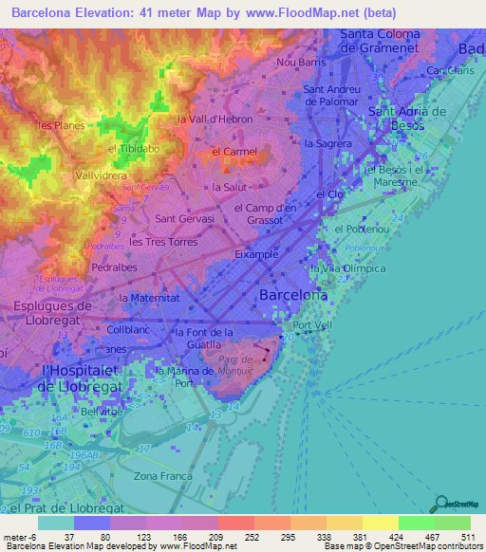
Altitude explains the e-bike allocation — students commute uphill
FINDING 2
Avg altitude & 6am e-bike stock by cluster
Cluster | Altitude | E-bike share @ 6am
UB / UPC Nord | 84.7 m | 18.8%
UB / UPC Sud | 24.9 m | 7.5%
UPF Ciutadella | 6.1 m | 5.7%
The commute direction
Students commute FROM low-altitude residential areas (Eixample, Gràcia) TO the UB/UPC Nord campus at 85m. They need e-bike assist going uphill — Bicing's allocation reflects this. The other clusters are relatively flat:
mechanical bikes suffice.
Supply-side decision, not just demand
Low e-bike availability at UPF/Sud is not because students don't want e-bikes — The problem is that allocated supply gets exhausted during the day when they do need it to get back home from school.
Notes:
Nord sits at an average of 85 metres — UPF Ciutadella is at 6 metres.
Students commute uphill from Eixample and Gràcia to campus, so they need electric assist.

Slide 6
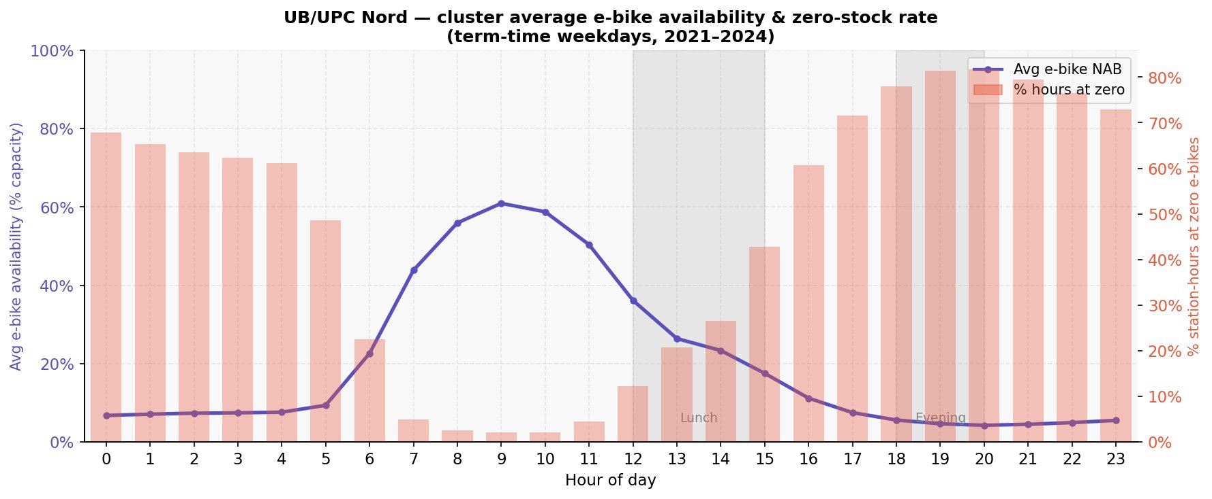
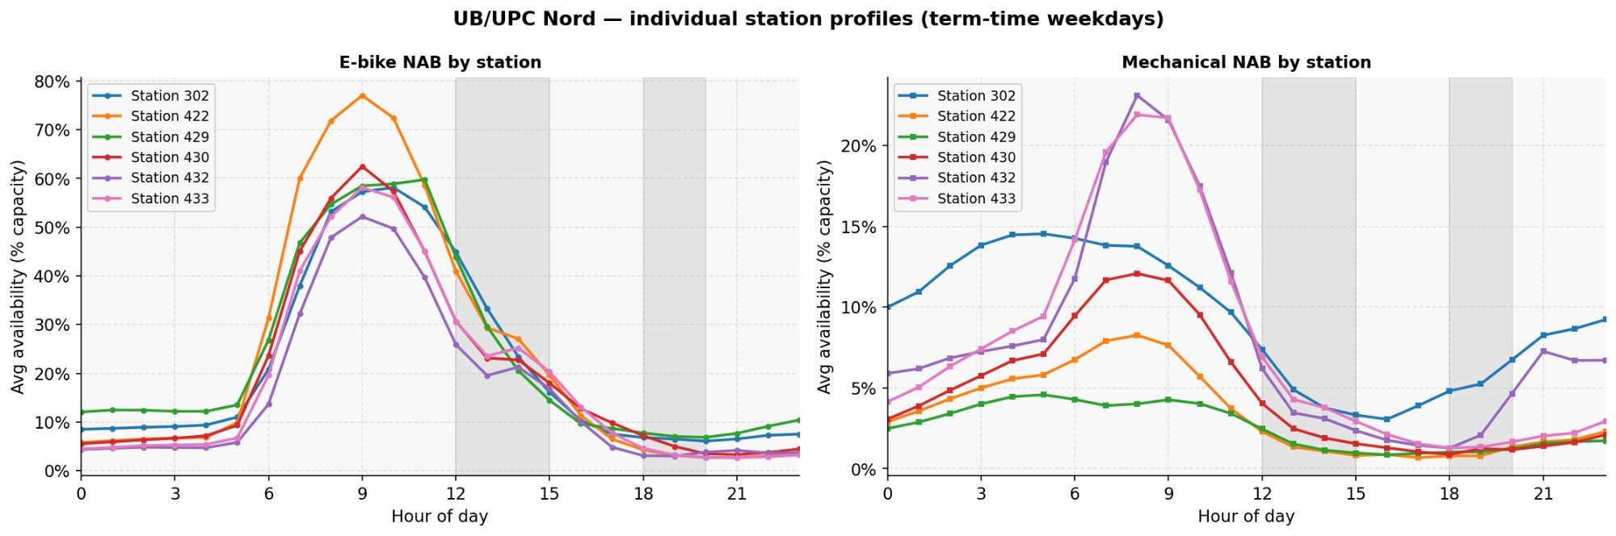
The drain pattern: peak at 9am, empty by afternoon
FINDING 3
~ 9am
e-bike peak (60% capacity)
> 80%
stations at zero by 19:00
All 6
stations show same drain pattern
Individual stations (bottom) show consistent behaviour — no outliers. Cluster averaging is justified.
Notes:
E-bikes peak at around 60% capacity at 9am as students arrive and bikes return to campus from homes.
Then demand takes over. After 1pm we start seeing a drop in availability, around 5pm we hit zero and stay at 0 until 5am the following day.
The bikes don't disappear — they are likely docked in residential areas overnight and come back the following morning.
The pattern is mostly consistent across all 6 stations, which justifies averaging them.

Slide 7
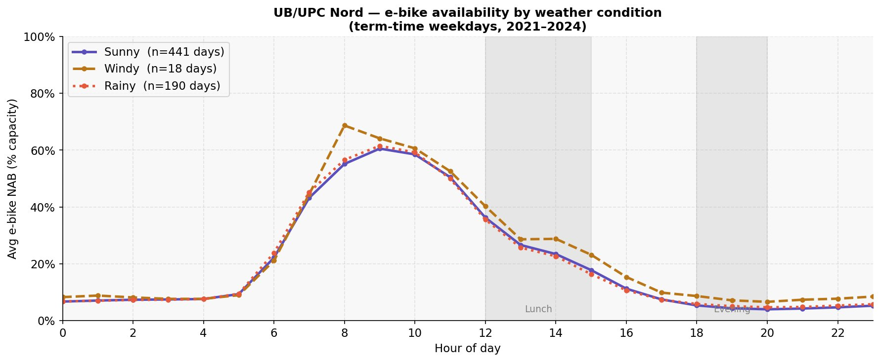
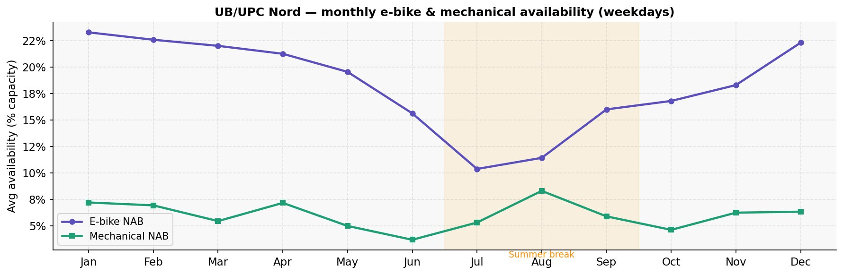
Weather has limited impact — but summer tells a different story
FINDING 4
Weather: minimal effect on drain
Sunny, rainy and windy days follow nearly identical profiles. Students commuting uphill appear committed regardless of light rain.
Windy days: slightly higher peak
Only 18 windy days in the dataset — treat with caution. Pattern may reflect coincidence rather than causal effect.
Summer: model not applicable
July–August shows a clear drop in e-bike availability. Fewer students commuting = less e-bike influx. The predictive model was trained on term-time weekdays only. Restocking is likely not needed in summer — different operational regime.
Notes:
Weather has almost no effect — sunny, rainy and windy days follow nearly identical profiles.
Summer July–August window shows a sharp drop, consistent with fewer students coming to campus.
I excluded weekends, summer months and overnight hours 10pm to 6am from the model
Overnight hours are easy to predict as they’re usually zero, but operationally irrelevant and I don't want the model to pick up that signal.

Slide 8
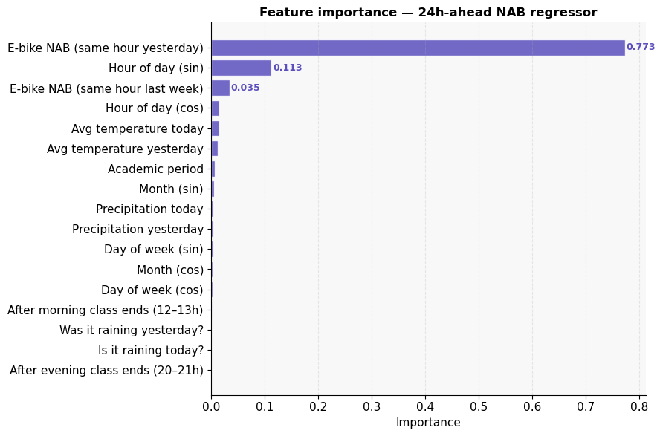
24h-ahead Random Forest: predicting hourly e-bike availability
MODEL
Why 24 hours ahead? Restocking requires lead time — a 3-hour model is too late to dispatch a van. Same-day rolling features (NAB_rolling_3h) are excluded: they are valid for live dashboards, not operational planning.
#1 NAB same hour yesterday (0.773)
The most powerful single signal. Yesterday's hourly pattern strongly predicts tomorrow’s NAB.
#2 Hour of day — sin (0.113)
The e-bike drain curve mirrors a sine wave almost exactly — rising sharply from 6am, peaking at 9am, falling through the afternoon.
#3 NAB same hour last week (0.035)
Same hour last week captures weekly behavioural rhythm. Especially useful for Mondays, where the 24h lag uses Friday's data
Baseline (NAB yesterday only): MAE ≈ 14.66% → Random Forest (all features): MAE ≈ 12.79% → 12.8% improvement over naive baseline
Notes:
I built a 24-hour-ahead Random Forest model predicting e-bike availability for each station-hour.
24 hours ahead because restocking requires lead time — a 3-hour model is too late to act on.
The top feature by far is e-bike availability at the same hour yesterday, with an importance of 0.77.
Second is hour of day encoded as a sine — the drain curve mirrors a sine wave almost exactly, so the model naturally leverages this.
Third is same hour last week, which captures weekly rhythm and is especially useful for Mondays where the 24h lag uses the previous Friday’s data considering weekends were dropped.
The model achieves a 12.8% improvement in MAE over the naive baseline of just using yesterday's data.

Slide 9
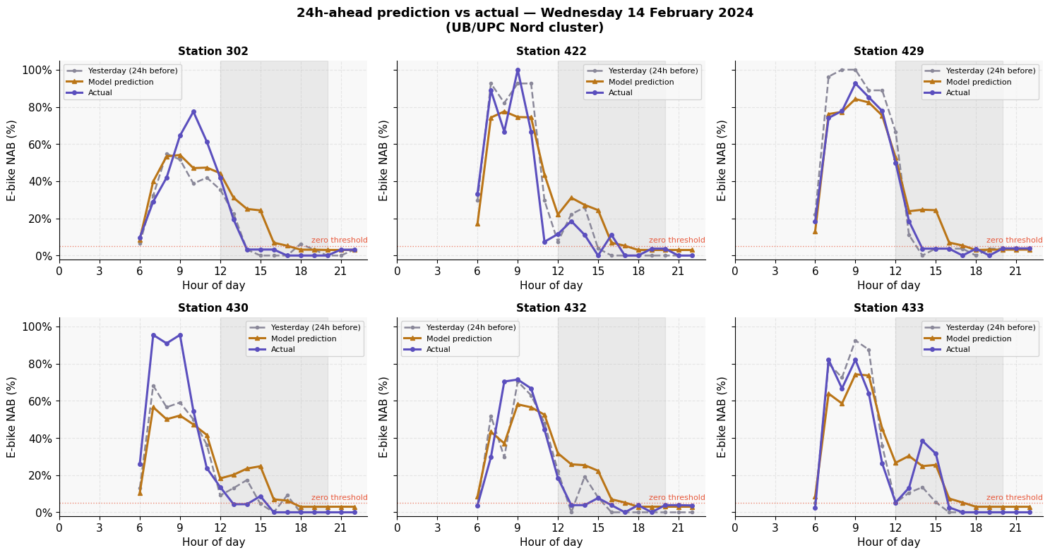
Yesterday (24h before)
Prediction vs actual —
Wednesday 14 February 2024
Model prediction
RESULTS
Actual
Zero threshold (5%)
Notes:
Here's the model on Valentine's Day 2024 — a typical term-time Wednesday.
You can see the gold line (model prediction) closely follows the the grey line (yesterday's data) and both are slightly off from the actual (blue line)
The model correctly anticipates the morning peak and gets quite close to the actual when predicting zero bike availability.

Slide 10
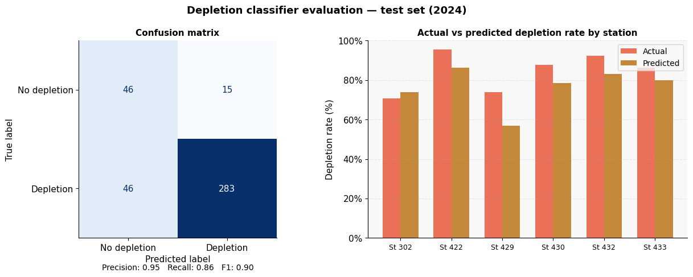
Can we predict which days will see sustained zero availability?
CLASSIFIER
Depletion event = predicted NAB < 5% for 1+ consecutive hours between 12:00–20:00 ·
Derived directly from the regression model output — no separate classifier trained
0.95
precision — low false alarm rate
0.86
recall — catches 86% of real depletions
F1: 0.90
overall classifier quality
Notes:
Derived from the same regression model, I flagged depletion events for the 3 month period January to March 2024—to see events where predicted NAB drops below 5% for at least one consecutive hour between noon and 8pm.
Precision is 0.95, meaning very few false alarms, so its unlikely the model will tell you to restock bikes on a day no restocking is needed.
Recall is 0.86 — the model catches 86% of real depletion days when restocking is actually needed.
Crucially, predicted depletion is usually slightly below actual, which means the restocking trigger is conservative — it only fires when the signal is strong.

Slide 11
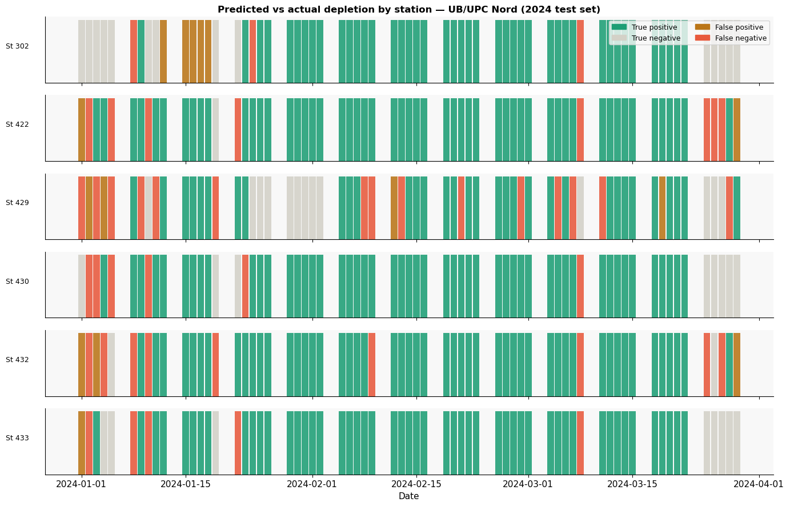
Notes:
The station-level timeline for January to March 2024 — each bar is one day per station.
Green is a correct depletion prediction, red is a miss.
The model performs well across the full test period.

Slide 12

Every zero-hour is lost revenue — and it adds up
REVENUE IMPACT
Revenue logic: Zero-availability hours × avg. departures when stocked × €0.10 = lost revenue per station-hour
Demand proxy: average e-bike departures at same hour on non-depleted days (conservative lower bound)
€314
~€942
€0.10
lost revenue Jan–Mar 2024 (6 stations)
projected annual loss (9 school months)
per missed e-bike ride
Why this number is conservative
We only count hours where availability = 0. Suppressed demand (riders who don't bother checking) and riders who walked past without trying are not captured.
The goal: make this model obsolete
If successful restocking eliminates zero-events (during the day when there is likely more demand), the model loses its training signal. That would be a good outcome — higher revenue and better service, more customers retained.
Notes:
Translating this into money:
Across just 6 stations, between January to March 2024, I found almost €314 in lost e-bike fee revenue from the stations operating at zero e-bikes between 1-10pm on school days
— projecting to roughly €942 for a full school year (9 months)
This is a conservative estimate: We can only measure actual demand when bikes are available. so real lost revenue is likely higher.
Riders who couldn’t get a bike when they needed one are invisible to the data — so real lost revenue is likely higher.
While calculating I had to estimate demand using same hour on days when bikes were available.
I multiplied estimated demand/missed rides by the zero availability hours and €0.10.

Slide 13
What the model doesn't know — and why that matters
LIMITATIONS
No student usage data
Public holidays not accounted for
The self-defeating model problem
We don't know how many UB/UPC students use Bicing. Enrolment + Bicing subscriber overlap would dramatically improve demand estimates.
Mondays after a Friday holiday get Friday's lag values. The error is small but worth noting for production deployment.
If restocking succeeds, depletion events disappear from the data. The model's training signal changes — it would need continuous retraining to stay valid.
School events & unpredictables
Summer requires a
separate model
Noise can be the
signal
Exam weeks, strikes, football matches near campus, and one-off events can spike or suppress demand in ways no historical model can anticipate.
July–September shows a fundamentally different regime. The current model should not be used for restocking decisions in summer.
Anomalies and outliers are often exactly the events operations need to plan for. ML models are weakest precisely on those rare but impactful days.
Notes:
The model has real limitations.
We don't know how many UB/UPC students actually use Bicing.
Public holidays aren't handled. S
chool events, strikes, and exam periods can spike or suppress demand in ways no historical model can anticipate.
Outlier days — the ones most worth predicting — are also exactly where the model struggles most
And the most interesting limitation: if restocking works and depletion events disappear, the training signal disappears too. The model would need continuous retraining.

Slide 14
Conclusions
📍
UB/UPC Nord is structurally under-supplied relative to student demand — altitude drives allocation, and daily drain is predictable.
🔮
A 24h-ahead Random Forest predicts hourly e-bike NAB with 12.8% lower error than the naive baseline — and catches 86% of depletion days.
💶
€314 in lost e-bike revenue across just 6 stations in 3 months. ~€942/year projected for the UB/UPC Nord school year — all recoverable with timely restocking.
⏰
Depletion is temporally structured but not identical everyday. The model enables targeted restocking as it predicts early depletion.
🔄
The best outcome is that this model becomes useless — successful restocking eliminates the signal. That means more revenue and happier students.
Notes:
To close: Nord is under-supplied, and the daily e-bike drain is predictable.
The model catches 86% of depletion days with 12.8% better accuracy than the naive baseline.
About 1000EUR/Year in lost revenue across these 6 stations could be recovered with timely restocking.
(Jump to this)
The best outcome is that this model eventually becomes useless. That would mean the problem is solved: Demand would be met but also potentially increase as we increase supply.

